Slide 1

Week 4 Artifacts
Team My Lil' HealthBot

Slide 2
Personal Goals
Jieneng Yang
Improve skills in hardware and software prototyping
Learn to work and collaborate in a multidiscipline group
Present user-oriented solution to real-world problems
Practice public presentation skills
Haoxin Guo
Gaining skills of programming Raspberry Pi.
Learning how to collaborate with a group. Be a good listener.
Improving critical thinking ability and communication techniques.
Fully understand the "narrative" building and modifying process.
Hanyu Zhao
Earning to work collaboratively
Improving craft skills and designing in a broader sense than fonts and paper
Understanding our target users and audience
Practicing on Slides design and public speaking skill
Sean Hsu
Develop my soft and analytic skills as a product manager.
Learn more about the product creation process from both my teammates and the studio team.
Designing products from a user’s perspective.
Learning more technical skills and pushing my own boundaries.

Slide 3
Team Goals
Prototype new features that will actually improve user experience
Learn more more about the robotics retailing industry
Help push each other’s boundaries and develop new skills
Learn to work together in diverse groups in a startup environment
Have fun!

Slide 4
Development Process
Weekly planning will occur on Tuesday after studio time.
During this meeting we will go through our retros from the previous week
Gather story/task for this week and prioritize them
Plan for the next week using the point system
Team will defined prioritization of the stories/task
Members will unanimously decide workload based on the point system
Unfinished user stories will be moved to next week
When coding, tasks should include unit testing (TDD)
Standups will be held on Friday and Sunday using hangouts
Go around everyone to see if they have issues and progress on weekly tasks
Sunday will also be used for gathering artifacts for the week and sharing weekly status
Each Sprint will last a week from (eg. Tuesday to Monday).

Slide 5
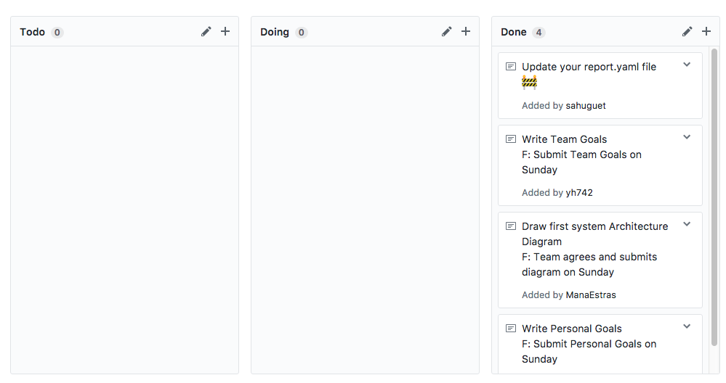
Weekly Progress Log

Slide 6
System Architecture Diagram

Slide 7

